Slide 1

Introduction to Management and Organisations
Organisational Theory and Practice

Slide 2
Learning Outcomes
Tell who managers are and where they work
Define management
Describe what managers do
Explain why it’s important to study management
Describe the factors that are reshaping and redefining management
Distinguish between Efficiency and Effectivity

Slide 3

Why Study Management?
Universality of Management
management is needed
in all types and sizes of organizations
at all organizational levels
in all work areas
management functions must be performed in all organisations
consequently, have vested interest in improving management

Slide 4
Universal need for management
All sizes of organisation
Small Large
All types of organisation
Profit Not-for-Profit
All areas within the organisation – marketing, production, information systems etc.
Management
is needed
in…
All organisation level
Top Bottom

Slide 5

Why Study Management?
The Reality of Work
most people have some managerial responsibilities
most people work for a manager
Challenges of Being a Manager
being a manager is hard work
must deal with a variety of personalities
must motivate workers in the face of uncertainty
Rewards of Being a Manager
create an environment that allows others to do their best
provide opportunities to think creatively
help others find meaning and fulfilment
meet and work with a variety of people

Slide 6
Who Are Managers? What are Organisations
Organisation
A deliberate arrangement of people brought together to accomplish a specific purpose.
Common Characteristics of Organizations
Distinct purpose
People working together
A deliberate systematic structure
Notes:
Managers work in organizations. We define organizations as A deliberate arrangement of people brought together to accomplish some are deliberate arrangements of people to accomplish a specific purpose. Examples include your college or university, the United Way, your neighborhood convenience store, the Dallas Cowboys football team, fraternities and sororities, the Cleveland Clinic and Nokia.

Slide 7


How Are Managers Different from Nonmanagerial Employees?
Nonmanagerial Employees
People who work directly on a job or task and have no responsibility for overseeing the work of others.
Examples, associates, team members
Managers
Individuals in organizations who direct the activities of others.
Notes:
For simplicities sake, we can divide organization members into two categories: nonmanagerial employees and managers. Nonmanagerial employees do not oversee the work of others. Managers direct and oversee the activity of the people in the organization.

Slide 8
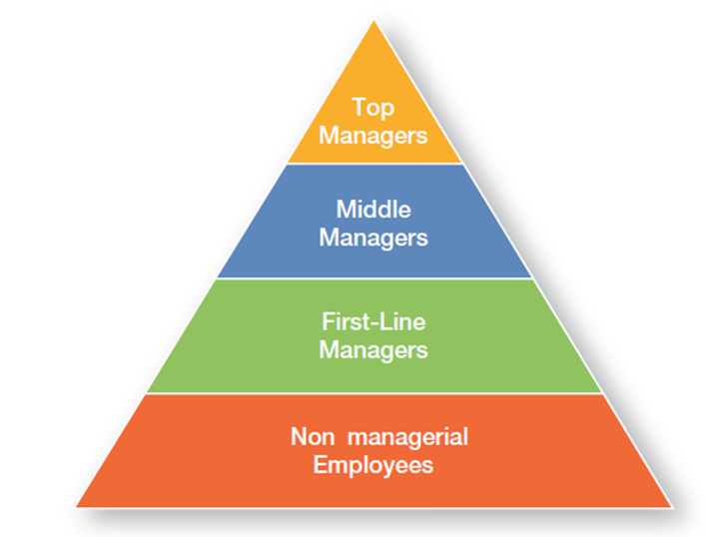
Management Levels
Top Managers
Responsible for making decisions about the direction of the organization.
Examples; President, Chief Executive Officer, Vice-President
Middle Managers
Manage the activities of other managers.
Examples; District Manager, Division Manager
First-line Managers
Responsible for directing nonmanagerial employees
Examples; Supervisor, Team Leader

Slide 9

What Is Management?
Management
The process of getting things done effectively and efficiently, with and through people
Effectiveness
“Doing the right things”, doing those tasks that help an organization reach its goals
Efficiency
Concerned with the means, efficient use of resources like people, money, and equipment
Notes:
Management is a process of getting things done, effectively and efficiently, with through people. A process is a set of ongoing and interrelated activities. In our definition it refers to the primary activities or functions managers perform.

Slide 10
Element defining Management
Process: Represents ongoing functions or primary activities engaged in by the managers
Coordinating: Distinguishes a managerial position from a non-managerial position

Slide 11
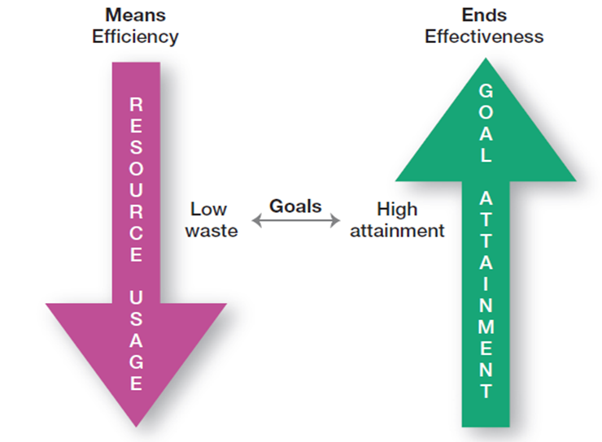
Efficiency v Effectivity
Do Things Right
Do Right Things
Notes:
The words efficiency and effectivity are often incorrectly used interchanged. While efficiency is about achieving optimal output, effectivity focus on achieving the goals

Slide 12
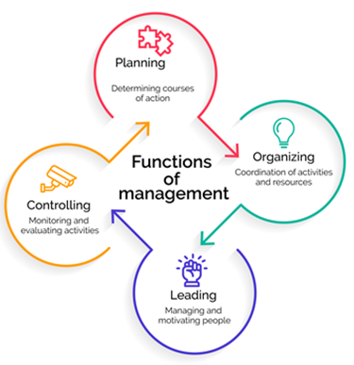
What do Managers Do?
Planning
Defining the organizational purpose and ways to achieve it
Organizing
Arranging and structuring work to accomplish organizational goals
Leading
Directing the work activities of others
Controlling
Monitoring, comparing, and correcting work performance
Notes:
Planning includes defining goals, establishing strategy, and developing plans to coordinate activities. Organizing includes determining what tasks need to be done and by whom. Leading includes motivating, directing the activities of others, and resolving conflicts. Controlling involves monitoring, comparing, and correcting work performance.

Slide 13

What do Managers Do? (cont.)
Management Process and Functions
A set of ongoing decisions and work activities that involve planning organising leading and control
The managerial activities are usually continuous

Slide 14
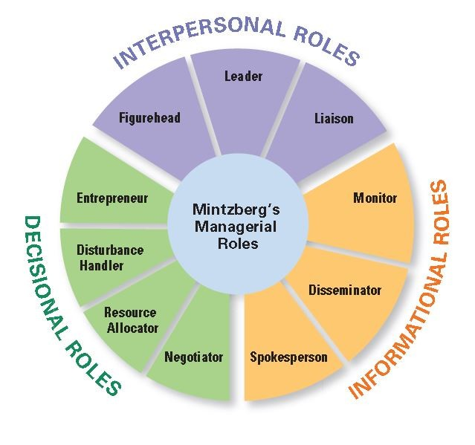
What Roles Do Managers Play?
Henry Mintzberg observed that a manager’s job can be described by ten roles performed by managers in three general categories
Notes:
In the 1960s, Henry Mintzberg did an empirical study of chief executives and discovered that managers were engaged in a number of varied, un-patterned, and short-duration activities. He defined management by categorizing what managers do based on the managerial roles they perform at work.

Slide 15
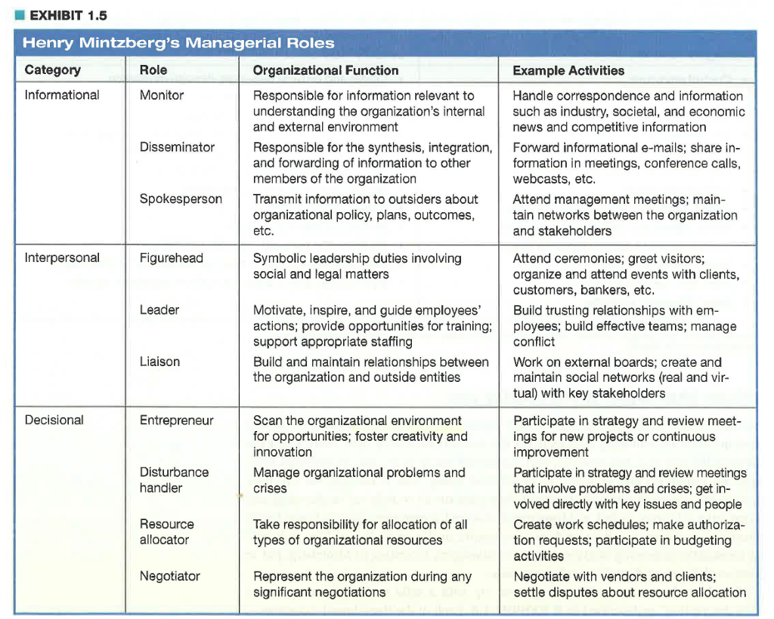

Slide 16
What Skills Do Managers Need?
Robert Katz and others describe four critical skills in managing
Conceptual Skills
Used to analyze complex situations
Understand relationship among different units
Interpersonal Skills
Used to communicate, motivate, mentor and delegate
Technical Skills
Based on specialized knowledge required for work
Political Skills
Used to build a power base and establish connections
Notes:
Another way to describing what managers do is by looking at the skills they need in managing. Managers must possess four critical skills in managing. Conceptual skills, Interpersonal Skills, Technical Skills and Political Skills.

Slide 17
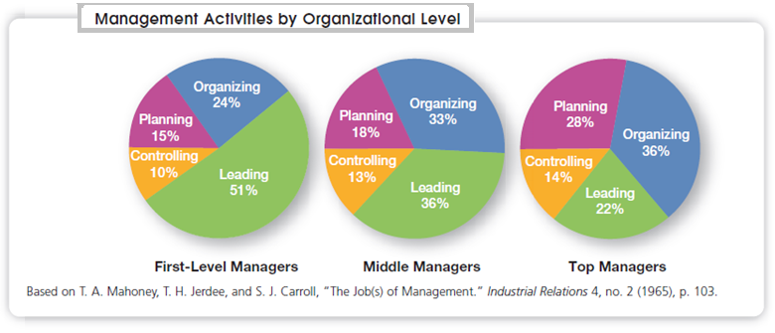

Slide 18

Managing Systems
– System - a set of interrelated and interdependent parts
arranged in a manner that produces a unified whole
• It provides a more general and broader picture of what
managers do than the other perspectives provide
– Closed system - not influenced by and do not interact
with their environment
– Open system - dramatically interact with their environment
• organizations - take in inputs from their environments
– transform or process inputs into outputs
– outputs are distributed into the environment

Slide 19
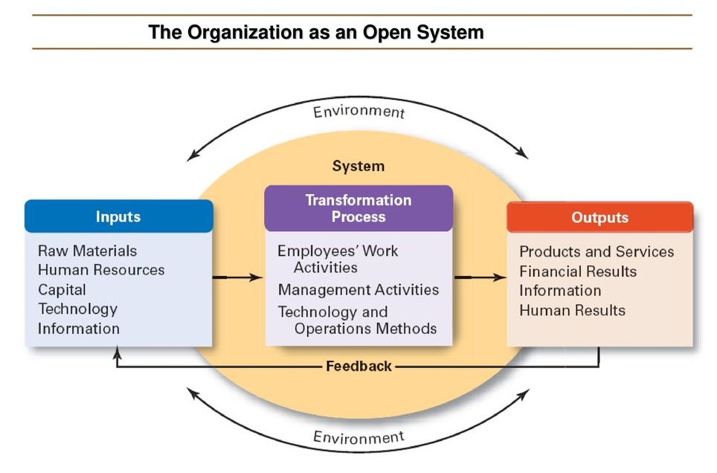

Slide 20
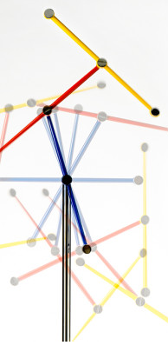
Managing Systems
managers must
• coordinate various work activities
• ensure that interdependent parts work together
• recognize and understand the impact of various external factors
decisions and actions taken in one organizational area will affect other areas and vice versa

Slide 21

Managing in Different and Changing Situations
– require managers to use different approaches and techniques
– Contingency perspective - different ways of managing are required in different organisations and different circumstances
• stresses that there are no simplistic or universal rules
• contingency variable

Slide 22

Common Contingency Variables
Organisation Size
Routiness of the Task
Environmental Uncertainty
Individual’s personality
Culture

Slide 23
What are Organisations
a deliberate arrangement of people to accomplish some specific purpose
elements of definition
each organization has a distinct purpose
each organization is composed of people
all organizations develop some deliberate structure
– today’s organizations have adopted:
flexible work arrangements
open communications
greater responsiveness to changes

Slide 24
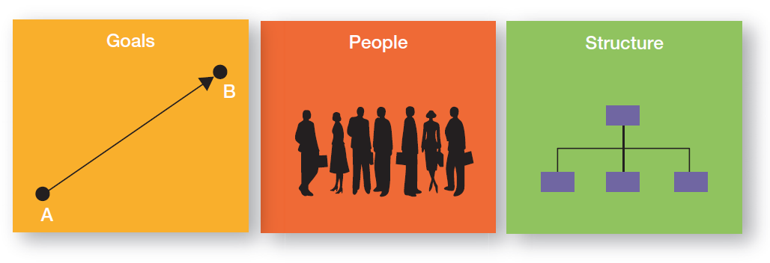
Three main characteristics of Organisations

Slide 25
Changing nature of organisations
Traditional Organisations | Contemporary Organisations
Stable Rigid Job-focused Work defined by job positions Stability of job Command-oriented Managers make decision Rule-oriented Relatively homogenous workforce Hierarchical relationships Work within organisation structure and specified time | Dynamic Flexible Skills focused Work defined by tasks Career oriented Involvement oriented Employees participate in decision Customer-oriented Diverse Work force Lateral and networked relations Work time and place flexible based on task

Slide 26
The End

